Slide 1



Amrita Vishwa Vidyapeetham
Department of Electronics and Communication Engineering
23ECE381 Open Lab- 1
Review -1
LDR Logic-Based Color Detection and Sorting System
Presented by :
Aathithya Pranav - CB.EN.U4ECE23002
Adarsh B - CB.EN.U4ECE23004
Ezhilkirthik M - CB.EN.U4ECE23016
Batch-A2

Slide 2
Abstract
  Detects and sorts 7 surface colors in real time using optics, LDRs, and digital logic.
  White LED ensures consistent illumination for accurate color detection.
  Three LDRs with RGB filters sense reflected light from the object.
  Comparator circuits convert analog signals into a unique 3-bit digital code.
  Decoder interprets the code to identify the color.
  Servo motor directs the object to the correct sorting bin.
  Entire system works on analog + digital components

Slide 3
Literature Survey
Title of Paper/Website | Source | Inferences from this Paper/Website
Conveyor Line Color Object Sorting using A Monochrome Camera, Colored Light and RGB Filters | arXiv preprint, Feb. 2025 23rd Annual Hawaii International Conference on Education, Ja n . 4-7, 2025, Honolulu, Hawai | • Used color filters for accurate color segmentation. • Demonstrated object sorting on conveyor using basic vision + filter technique.
Designing of RGB Color Detector | Int. J. of Recent Development in Engineering and Technology, Aug. 2014 | • Gave insight into RGB sensor circuit design. • Helped identify how to calibrate colors using photodetectors.
Design and development of a low cost colour sensor and its application in angular position control system of a stepper motor | Int. J. of Electronics and Computer Science Engineering (IJECSE), 2013 | • Inspired microcontroller-free color sensing circuit idea. • Linked color detection with motor-based sorting system.

Slide 4
Title of Paper/Website | Source | Inferences from this Paper/Website
Automated Color Sensor System Using LDR and RGB LEDs Controlled by Arduino Ahmad Amhani and Zaki Iqbal | Dept. of Engineering, American University of Ras Al Khaimah, UAE | • Demonstrated a simple yet reliable method using sequential RGB illumination with LDR response. • Emphasized calibration of color thresholds using analog voltage outputs and mapping logic.
WWCS – World’s Worst Color Sensor (Project14 Photonics Challenge) | Element14 Community Blog, Photonics Challenge | • Showed wavelength-based color separation technique and caturing all the reflected light from the object . • Inspired use of geometry and filter design for analog color capture.

Slide 5
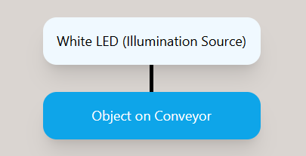
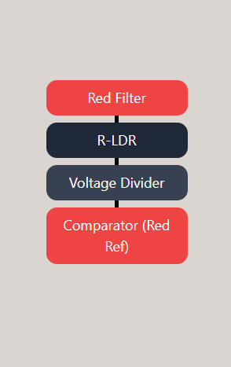
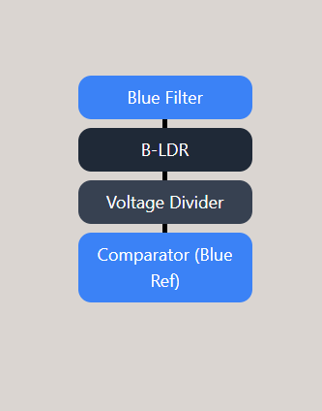
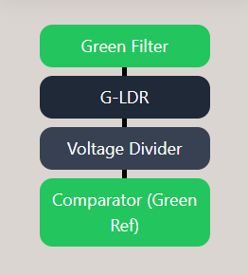
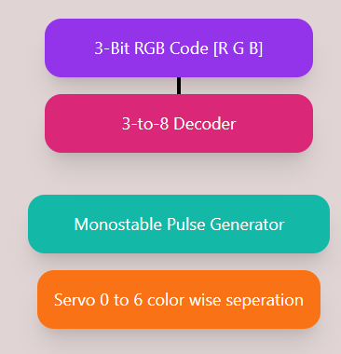
Block diagram

Slide 6
Working Principle
1. Illumination & Reflection:
  A single high-intensity White LED illuminates objects on a closed conveyor belt.
  Each object reflects a specific combination of red, green, and blue light components based on its surface color.
2. Sensing & Processing:
  Three LDRs behind RGB filters detect specific reflected light wavelengths (R: 600–700 nm, G: 500–600 nm, B: 400–500 nm).
  LDR resistance varies with light intensity, generating color-specific signals.
  Voltage divider circuits convert resistance to analog voltage.
3. Digital Conversion & Decoding:
  Comparator circuits compare analog voltages with reference levels and output binary HIGH (1) or LOW (0).
  The three outputs (R, G, B) form a 3-bit digital code (e.g., 001 = Blue, 011 = Cyan).
  This code is input to a 3-to-8 decoder, which activates one unique output corresponding to the detected color.

Slide 7
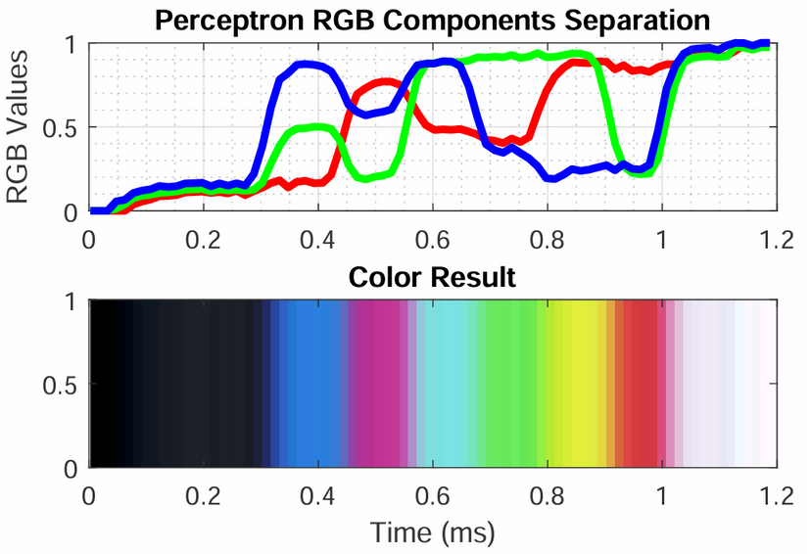
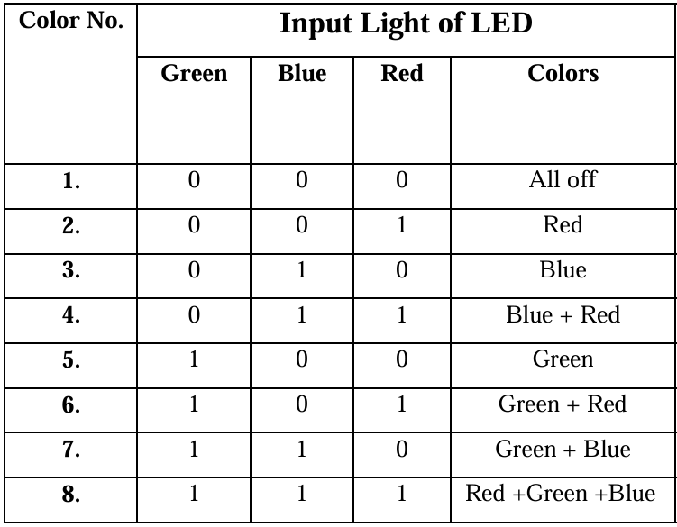
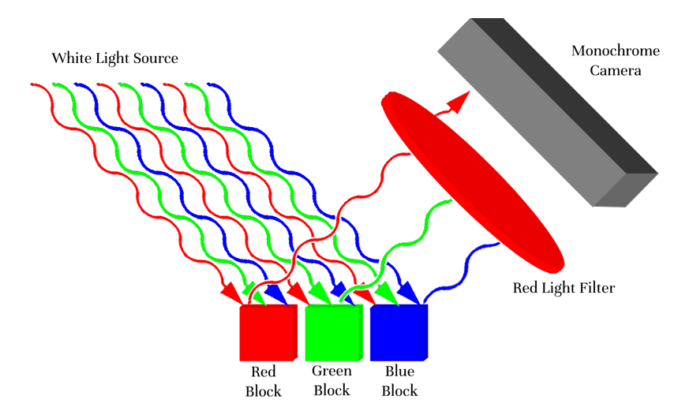
Graphs from Research Paper
LDR

Slide 8
Inference
  Real-time color identification and sorting without microcontrollers or programming.
  Operates entirely on analog and digital electronics for a cost-effective solution.
  LDRs with RGB filters detect reflected light from objects on a conveyor belt.
  Light signals converted to voltage, processed via op-amps and comparators.
  Signals translated into a 3-bit binary RGB code for color representation.
  3-to-8 decoder activates actuators to sort objects by color.
  555 timer (monostable multivibrator) ensures precise sorting timing.
  Capable of identifying up to 7 distinct colors.

Slide 9
Reference
[1] I. Mazumdar, R. Mondal, and S. Pal, “Design and development of a low cost colour sensor and its application in angular position control system of a stepper motor,” Int. J. Electron. Comput. Sci. Eng. (IJECSE), vol. 2, no. 4, pp. 1241–1251, 2013.
[2] T. K. Binnar, D. D. Deoghare, P. N. Patil, and V. S. Kulkarni, “Designing of RGB Color Detector,” Int. J. Recent Dev. Eng. Technol., vol. 3, no. 2, p. 12, Aug. 2014.
[3] M. Petersen, B. Lakenen, K. Chavan, P. Waghmare, A. Sergeyev, and N. Rawashdeh, “Conveyor line color object sorting using a monochrome camera, colored light and RGB filters,” in Proc. 23rd Annu. Hawaii Int. Conf. Educ., Honolulu, HI, USA, Jan. 4–7, 2025.
[4] A. Amhani and Z. Iqbal, “Automated color sensor system using LDR and RGB LEDs controlled by Arduino,” ARPN J. Eng. Appl. Sci., vol. 12, no. 19, pp. 5532–5535, Oct. 2017.
[5] D. P. Martin, “WWCS — World’s Worst Color Sensor — Project14 Photonics Challenge,” element14 Community, Jul. 2, 2018. [Online]. Available: https://community.element14.com/challenges-projects/project14/photonics/b/blog/posts/wwcs---world-s-worst-color-sensor---project-14-photonics-challenge. [Accessed: Jul. 19, 2025].

Slide 10
Amrita Vishwa Vidyapeetham
Department of Electronics and Communication Engineering
Thank
You

